Slide 1
Making Sense of New Inhaled Therapies in COPD
Jeff Garrett

Slide 2

Notes:
Shouldn’t we really standardise the test, to include the FULL BD RESPONSE, how would we do that?

Slide 3
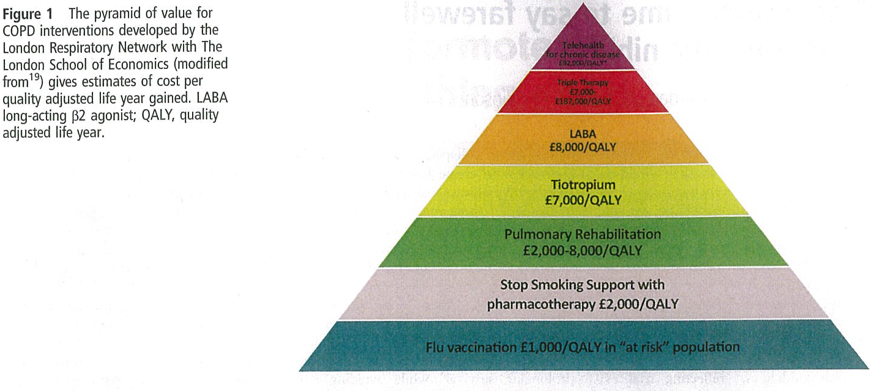
Pyramid of value for COPD interventions

Slide 4
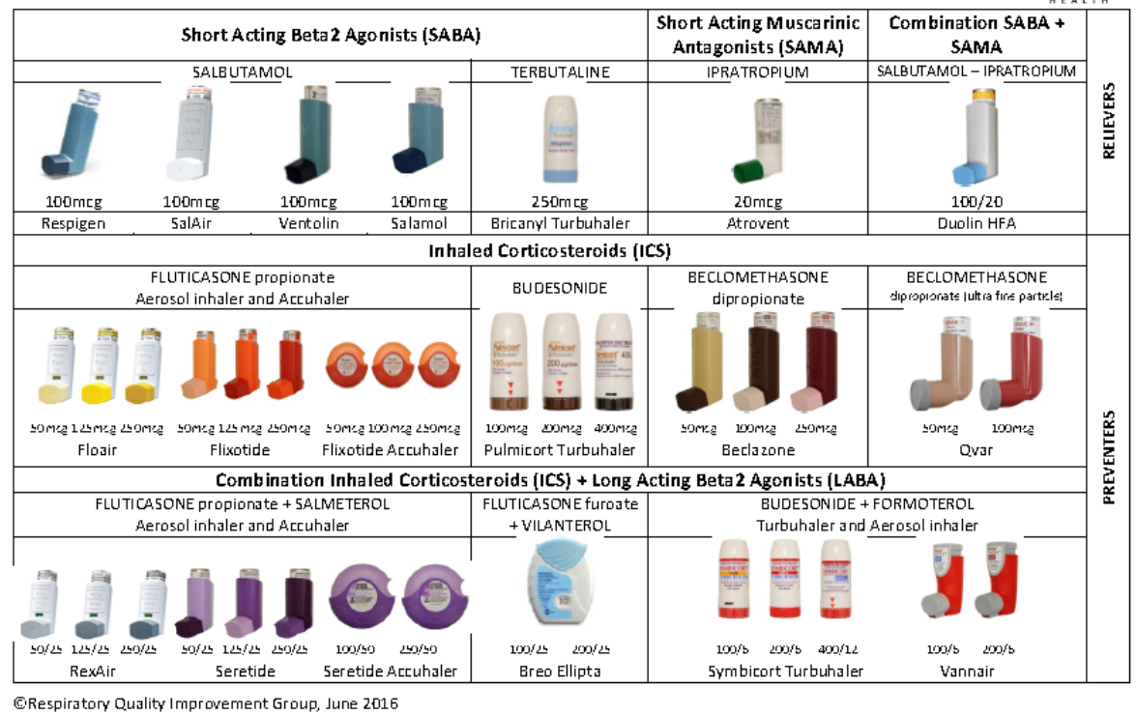
Inhaler Chart

Slide 5
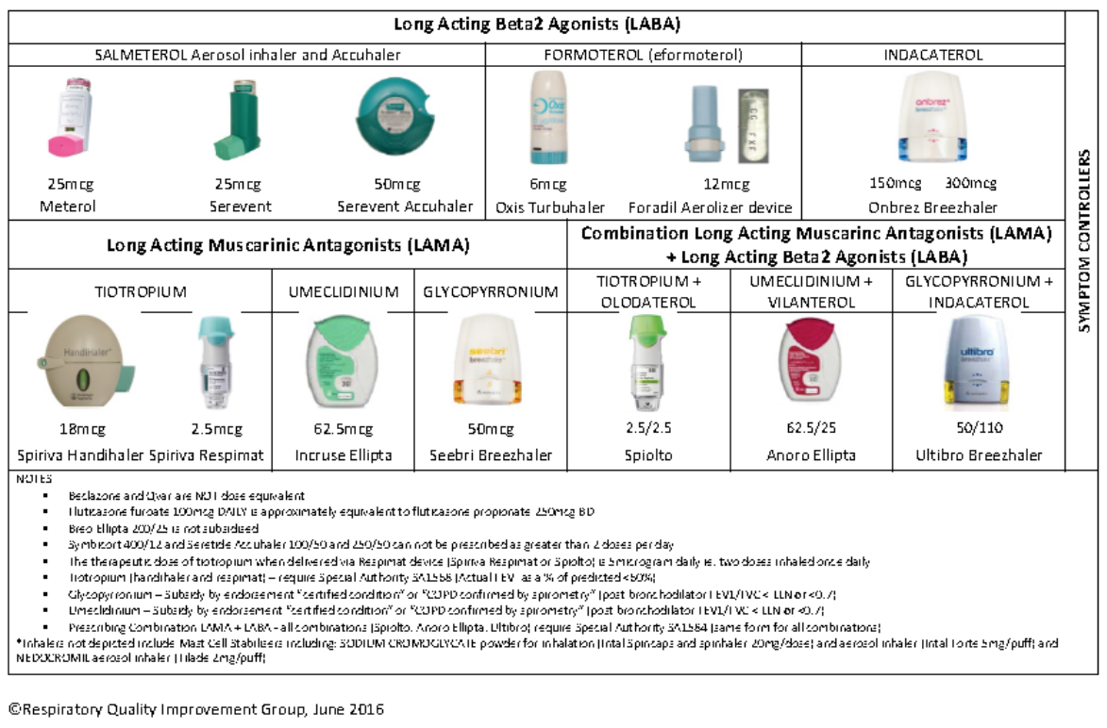
Inhaler Chart LABA/LAMA/LABA+LAMA

Slide 6
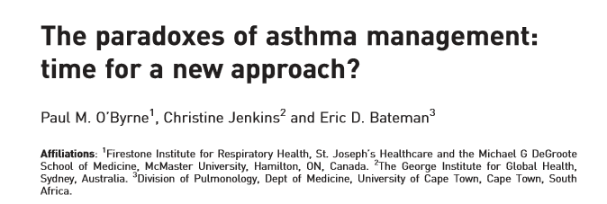


Slide 7
Paradoxes of asthma management¹
Recent publication
Paradox 3: Patient misconception that SABA provides the most benefit, despite a switch from SABA “prn” to ICS fixed dose at Step 2
Paradox 5: Dislocation between patient/doctor understanding of asthma control and frequency, impact & severity of symptoms
Treatment guidelines²
* Not for children<12 years
** For children 6-11 years, the preferred Step 3 treatment is medium dose ICS
# Low dose ICS/eformoterol is reliever for patients prescribed low dose budesonide/eformoterol or low dose beclometasone/eformoterol maintenance and reliever therapy
+ Tiotropium by mist inhaler is an add-on treatment for patients with a history of exacerbations; it is not indicated in children <12 years
Paradox 1: Step 1 SABA alone does not treat underlying inflammation associated with exacerbations
STEP 5:
Refer for
add on treatment
e.g. Tiotropium*⁺
Anti IgE
Anti IL- 5*
STEP 4:
Medium/high dose
ICS + LABA
Paradox 2: Conflicting message between “prn” SABA” at Step 1, but at higher steps a “fixed dose” (i.e. “preventer” ICS) is used
STEP 3:
Low dose
ICS + LABA**
STEP 1
STEP 2:
Low dose ICS
PREFERRED CONTROLLER
Consider low dose ICS
LTRA/Low dose theophylline*
Med/high dose ICS
Low dose ICS+LTRA
(or +theoph*)
+ tiotropium*⁺
High dose ICS + LTRA (or +theoph*)
Low dose OCS
Other controller
options
Paradox 4: Conflicting safety message: “SABA alone (step 1) is safe & LABA alone (step 3) unsafe”
RELIEVER
“As needed” SABA
“As needed” SABA or low dose ICS/formoterol#
Poor patient understanding and confusion
Overuse of SABA and underuse of preventers is reinforced by paradoxes in current treatment.¹
1. O’Byrne PM, et al. Eur Respir J 2017 7;50:1701103 [https://doi.org/10.1183/13993003.01103-2017]. 2. Global Strategy for Asthma Management and Prevention (GINA). Updated 2017.
LTRA: leukotriene antagonist; OCS: oral corticosteroid
SABA: short acting beta₂-agonist; Theophy: theophylline
Notes:
LINK: In a recent 2017 publication, experts have suggested that overuse of SABA and under-use of preventers is reinforced by a number of paradoxes in our current treatment approach to asthma.¹
KEYPOINTS:
Current steps included in treatment guidelines, such as GINA (Global Initiative for Asthma), may unintentionally confuse patients and lead to poor understanding, reinforcing the inappropriate overuse of SABA and poor adherence to preventer medication.
The authors propose 5 paradoxes. The most important ones we’ll discuss are paradox 1, 2 and 3.
Paradox 1: “prn SABA” alone is introduced at step 1, but this does not treat the underlying inflammation. This approach reinforces the central role of SABA in asthma management, and sets a mindset to treat only when experiencing symptoms. Furthermore, the rapid relief of symptoms with SABA use, reinforces the “hero status” of the SABA inhaler.
Paradox 2: At step 1, the patient has autonomy (i.e. they treat only when they think they have symptoms). This self-management approach at Step 1, however, is at odds with Step 2, when the patient is asked to begin regular maintenance (“preventer”) medication, even when asymptomatic.
Paradox 3: The patient perceives SABA to be the most effective inhaler, despite a switch to a “fixed-dose” (i.e. regular maintenance ICS) at Step 2. Effectively, patients are required to “unlearn” their management approach at Step 1. Often patients are given more than one inhaler at this stage, which can be confusing. However, patients quickly learn the reliever works “quickly” reinforcing the misconception that it is the one that works, so they don’t need the preventer inhaler.
REFERENCE:
O’Byrne PM, et al. Eur J Respir J 2017;50:1701103.

Slide 8
The 5 Paradoxes of Asthma Guidelines
1. Step 1 SABA alone does not treat underlying inflammation
2. Conflicting message PRN at stage 1 but fixed dose ICS at Stage 2
3. Pt misconception: SABA provides most benefit….ie introduced first
4. SABA alone safe but LABA alone is not!
5. Dislocation between pt/doctor understanding of asthma control and impact/severity of Sx

Slide 9
Under-utilisation of ICS is associated with an increased risk of death from asthma¹
Fitted rate ratio for death from asthma as a function of the number of canisters of
inhaled corticosteroids used during the year before the index date¹
“The rate of death from asthma decreased by 21 percent with each additional canister of inhaled corticosteroids used in the previous year (adjusted rate ratio, 0.79; 95 percent confidence interval, 0.65 to 0.97).”¹
Study design: A population-based epidemiologic study (nested case-control design) of case patients (n=66) and controls (n=2,681) with severe asthma, predominantly derived from the computerised data bases of Saskatchewan Health.
There were 562 deaths in the cohort, of which 77 were classified as being due to asthma. Mean age of case patients was 30 years (range, 9-54 years).¹
Adapted from Suissa S, et al. 2000.¹
1 out of 3 patients (34%) with uncontrolled asthma do not take their preventer medication.²
1. Suissa S, et al. New Engl J Med 2000;343:332-6. 2. Reddel HK, et al. Med J Aust 2015 May 18;202(9):492-7.
Notes:
LINK: Conversely, there is under utilisation of ICS, which is associated with increased risk of death.¹
KEYPOINTS:
Regular low dose inhaled corticosteroid are associated with a decreased risk of death from asthma;¹ however, one out of three patients (34%) with uncontrolled asthma do not take their preventer medication.²
This study showed that the rate of death from asthma decreased by 21% with each additional canister of inhaled corticosteroids used in the previous year (adjusted rate ratio, 0.79; 95% CI: 0.65-0.97).¹
The rate of death from asthma among users of inhaled corticosteroids as compared with nonusers was reduced by about 50% with the use of ≥ 6 canisters per year.¹
Conversely, this data suggests that sporadic use of inhaled corticosteroids (fewer than 4 canisters per year) may be associated with higher rates of death from asthma.¹
BACKGROUND:
Study design: A population-based epidemiologic study (with a nested case-control design) of case patients (n=66) and controls (n=2681) with severe asthma, predominantly derived from the computerised data bases of Saskatchewan Health. There were 562 deaths in the cohort, of which 77 were classified as being due to asthma. Mean age of case patients was 30 years (range, 9-54 years).¹
REFERENCES: 1. Suissa S, et al. New Engl J Med 2000;343:332-6. 2. Reddel HK, et al. Med J Aust 2015 May 18;202(9):492-7.

Slide 10
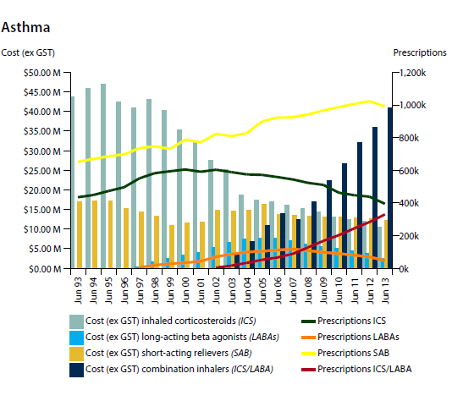

Slide 11
Over-reliance on SABA continues despite increased risk¹⁻³
Since 1980s we’ve known SABA overuse is associated with increased risk of exacerbation & asthma-related death but prescriptions for SABA monotherapy are still high³
An estimated
521,000 New Zealanders
take medication for asthma⁴
2.1 MILLION SABA inhalers* sold in NZ last year¹
*SABA: short-acting beta-2 agonist: including salbutamol and terbutaline for asthma and COPD.
1. Short Acting Beta Agonist (SABA) Inhaler Use - IMS data, AstraZeneca. Data on File, November 2017. 2. Pavord ID, et al. Lancet 2017; pii: S0140-6736(17)30879-6. doi: 10.1016/S0140-6736(17)30879-6. [Epub ahead of print]. 3. Reddel HK, et al. BMJ Open 2017;7:e016688. doi:10.1136/bmjopen-2017-016688. 4. Asthma and Respiratory Foundation New Zealand, Asthma Key statistics. Available at: https://www.asthmafoundation.org.nz/research/key-statistics. Information from the Asthma & Respiratory foundation NZ/University of Otago report: The impact of respiratory disease in New Zealand: 2016 update Accessed 11 Jan 2018.
Notes:
LINK: Over-reliance on the use of SABA (or “reliever only” medication) is still problematic.¹⁻³ Since the 1980s, we’ve known that overuse of “reliever-only” medication (i.e. SABA) increases asthma-related death;³ despite this, prescriptions for SABA single inhaler use in New Zealand are still high.¹
KEYPOINTS:
Despite 25 years of guideline development, and the known risk of increased risk of death with SABA overuse, a significant number of people with asthma still rely on SABA as their sole asthma treatment.³
DISCUSSION: Discuss with the audience:
Are you surprised by these statistics?
Why do you think so many people rely on SABA as their sole asthma treatment?
BACKGROUND: Information on SABA prescriptions in NZ is based on the latest 2017 IMS data.
REFERENCES:
Short Acting Beta Agonist (SABA) Inhaler Use - IMS data, AstraZeneca Data on File, November 2017.
Pavord ID, et al. Lancet 2017; pii: S0140-6736(17)30879-6. doi: 10.1016/S0140-6736(17).
Reddel HK, et al. BMJ Open 2017;7:e016688. doi:10.1136/bmjopen-2017-016688.

Slide 12
Results – Asthma controlled weeks
Primary end point
Bud-Form prn v Turbutaline prn – weeks of well controlled asthma 34.4 v 31.1% (OR 1.14, 95% CI 1.00-1.30, p=0.046)
Bud-Form prn v Budesonide BD – weeks of well controlled asthma 34.4 v 44.4%, OR 0.64, 95% CI 0.57-0.73

Slide 13
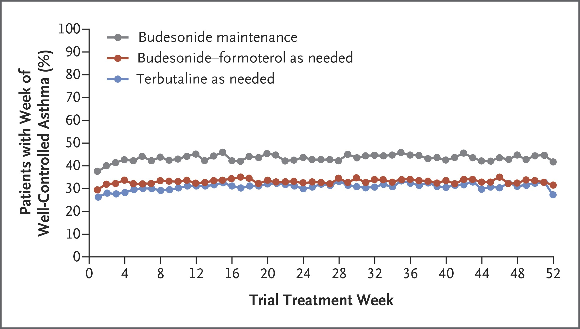

Overall Weeks of Well-Controlled Asthma, According to Data in the Electronic Diary.
O’Byrne PM et al. N Engl J Med 2018;378:1865-1876
Notes:
Figure 2 Overall Weeks of Well-Controlled Asthma, According to Data in the Electronic Diary.

Slide 14
GOLD 2018
- treatment recommendations
Group A (few exacerbations, less symptoms)
  Short-acting bronchodilators
Group B (few exacerbations, more symptoms)
  LABA or LAMA (if persistent symptoms) LABA and LAMA
Group C (frequent exacerbations, less symptoms)
  LAMA first (if more exacerbations) LABA and LAMA; possibly LABA and ICS
Group D (frequent exacerbations and more symptoms)
  LABA and LAMA (if more exacerbations) LABA and LAMA and ICS

Slide 15
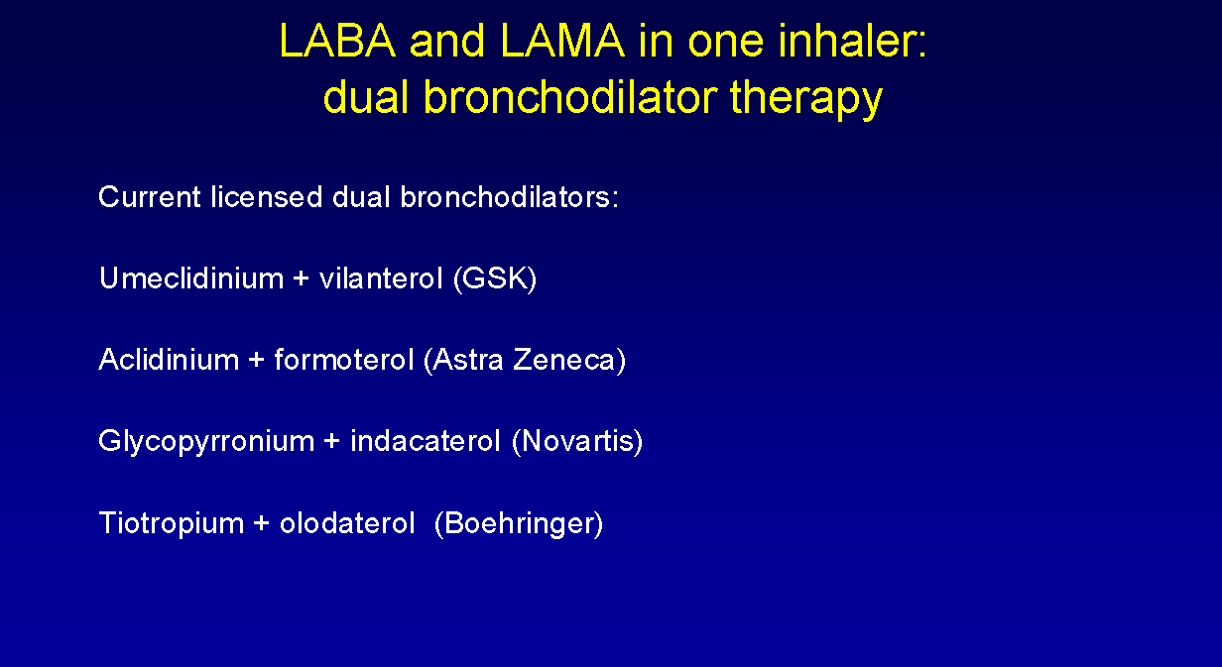
LABA+LAMA >LABA or LAMA

Slide 16
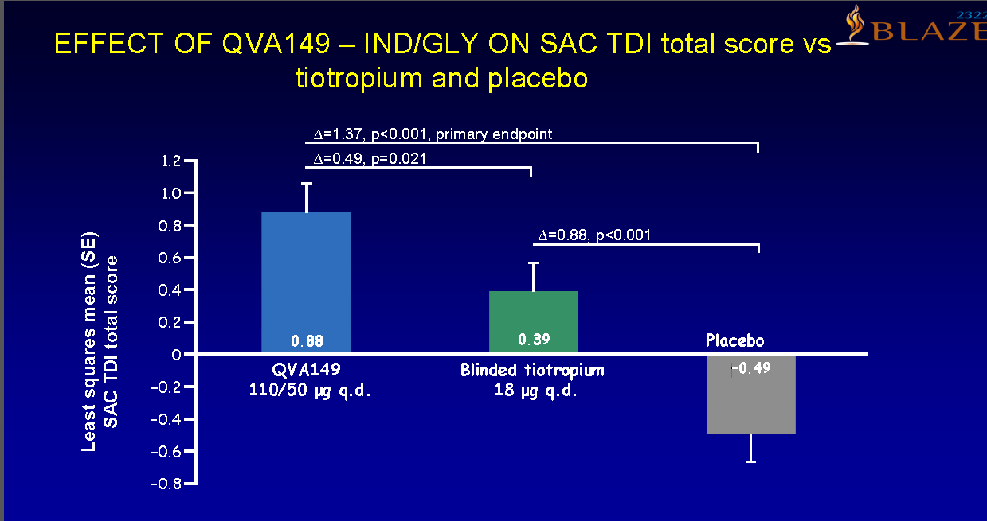
LABA +LAMA vs LAMA (Indacaterol + glycopyrronium vs tiotropium)

Slide 17
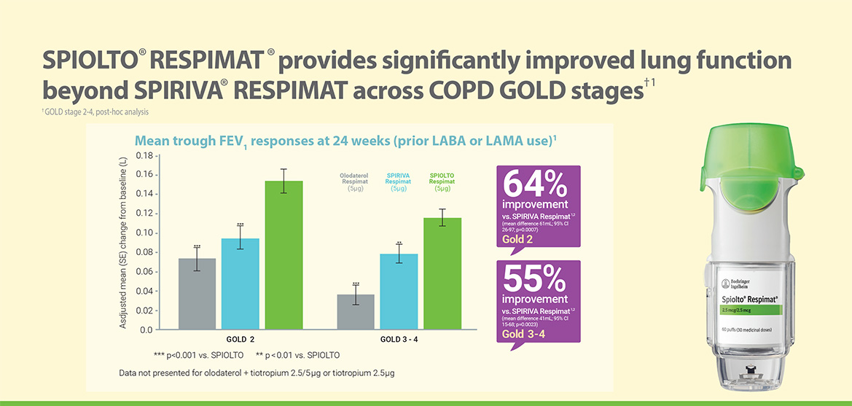
LABA+LAMA >LAMA>LABA wrt Lung Fn

Slide 18
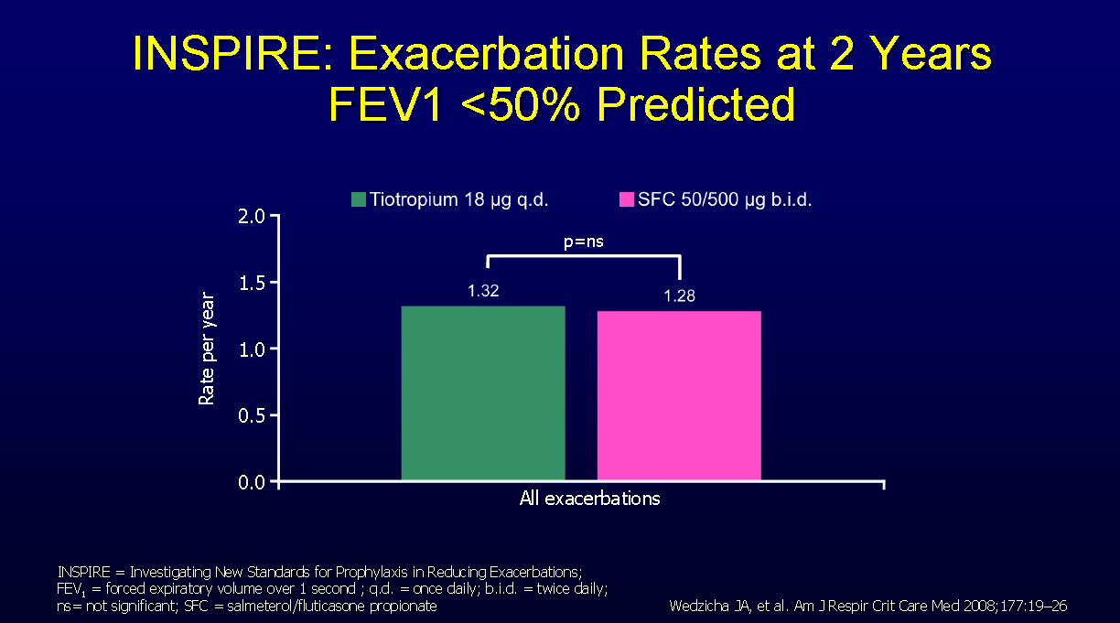
Spiriva vs Seretide on exacerbation rate COPD

Slide 19
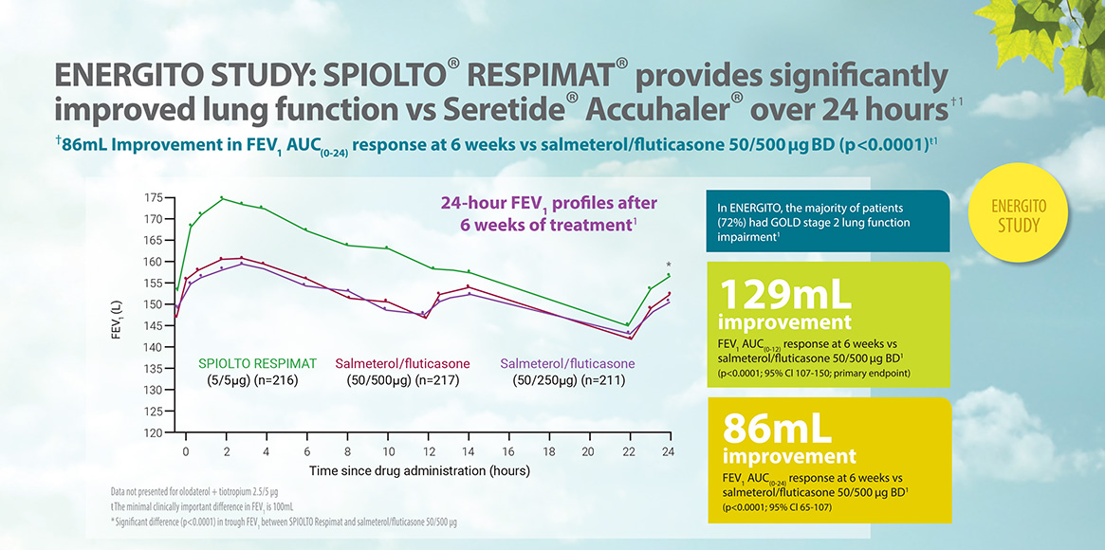
LABA/LAMA improves FEV1 > ICS/LABA in COPD

Slide 20
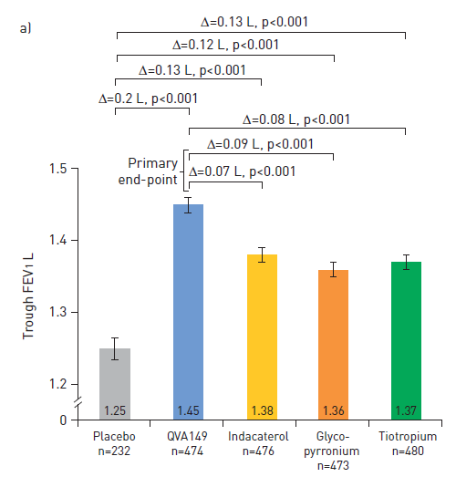
Indacaterol + Glycopyronium vs monotherapy and tiotropium- FEV1

Slide 21
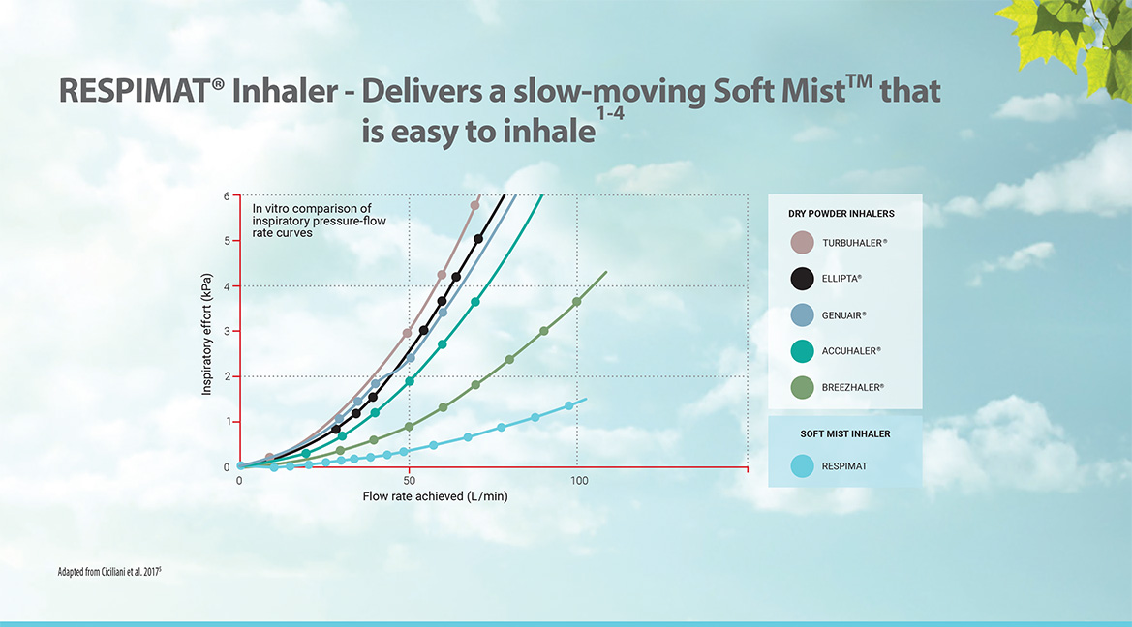

Slide 22
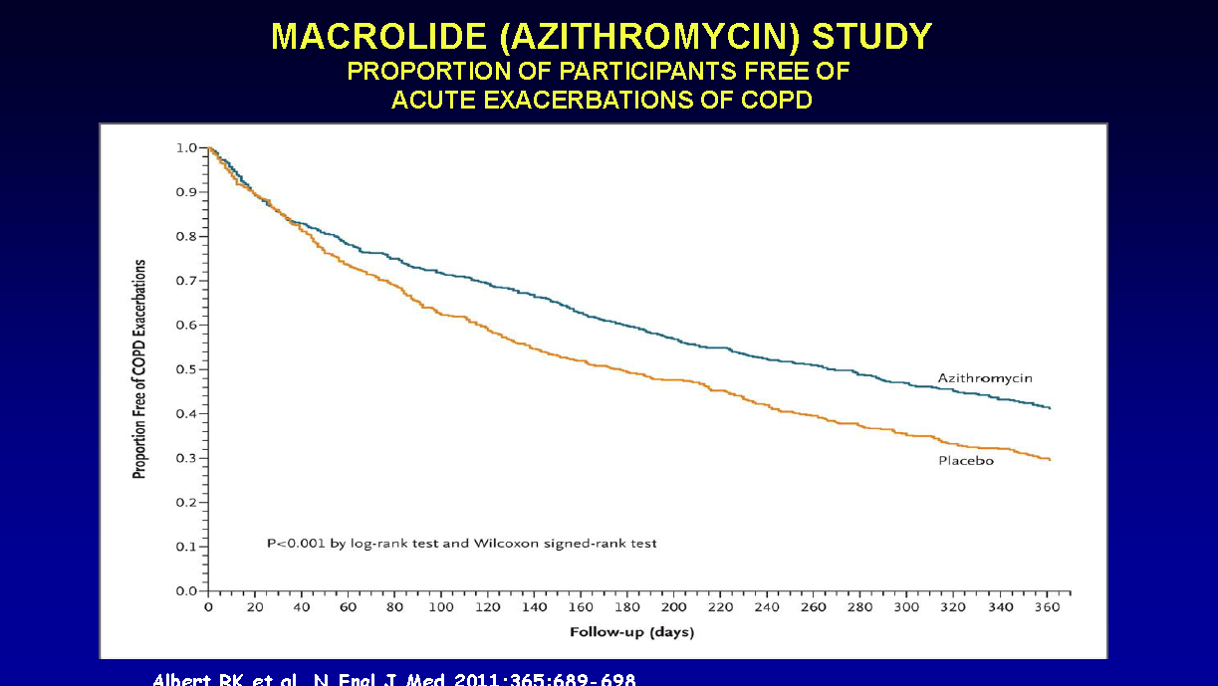
What about neutrophilic bronchitis?

Slide 23
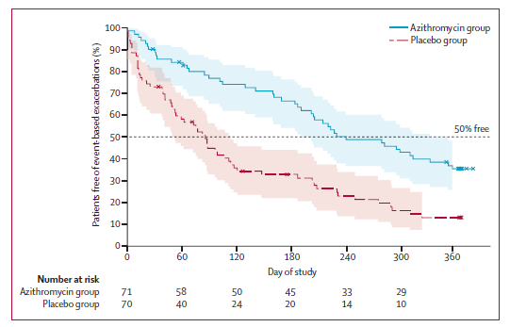
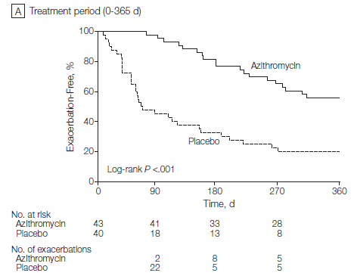
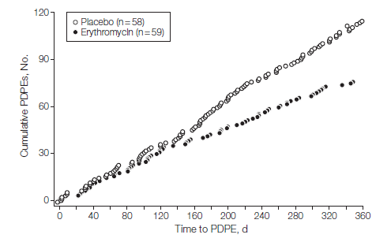
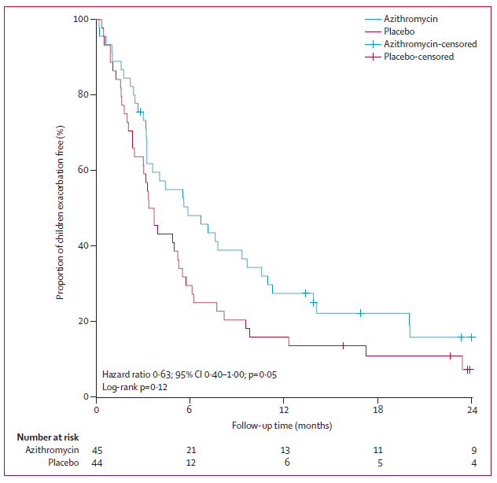
Time to first exacerbation
EMBRACE
BAT
BLESS
BIS
Notes:
23

Slide 24
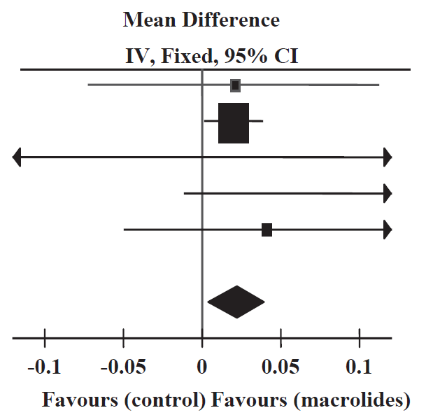
Lung function
FEV1
20 ml (p=0.01)
Wu et al. Respirology 2014;19:321

Slide 25
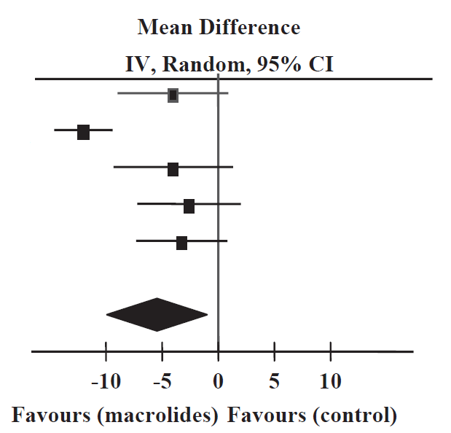
Health status
Total SGRQ
5.4 u (p=0.02)
Wu et al. Respirology 2014;19:321

Slide 26
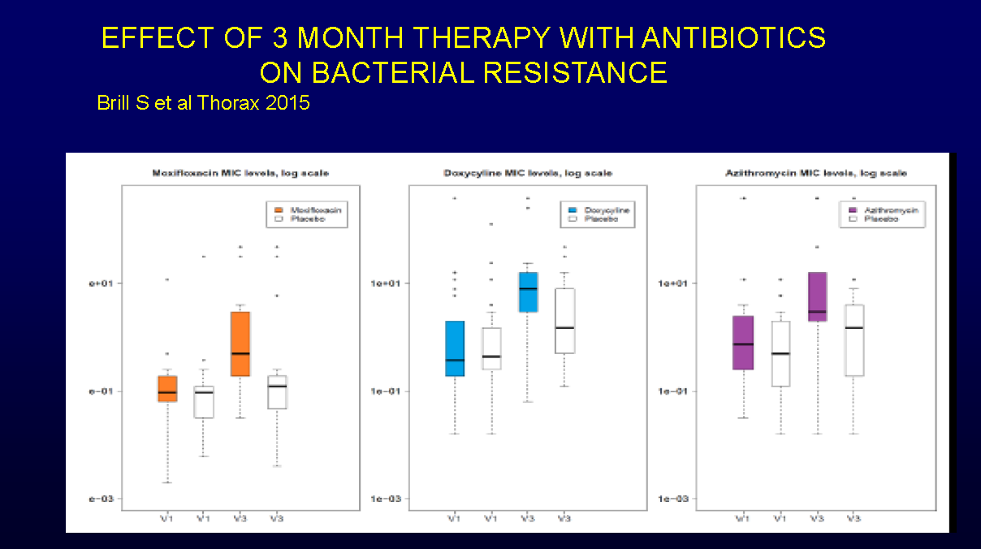
Antibiotic Resistance at 3 months

Slide 27
GOLD 2018
- treatment recommendations
Group A (few exacerbations, less symptoms)
  Short-acting bronchodilators
Group B (few exacerbations, more symptoms)
  LABA or LAMA (if persistent symptoms) LABA and LAMA
Group C (frequent exacerbations, less symptoms)
  LAMA first (if more exacerbations) LABA and LAMA; possibly LABA and ICS
Group D (frequent exacerbations and more symptoms)
  LABA and LAMA (if more exacerbations) LABA and LAMA and ICS

Slide 28
Summary Asthma
Use Symptoms (ACT), exacerbation frequency, SABA use, FEV1 , Eosinophil level to assess control
We are overusing SABAs +LABAs and underutilising ICS (dose)
Poor at back titration of ICS/LABA
Serum eosinophil and CRP for exacerbations guide Rx
Patients with longstanding asthma often have overlap syndrome (COPD)- ?place of azithromycin and LAMA
10% have severe asthma (mepo/omalizumab)
50% are poorly compliant (80% admitted pts)

Slide 29
Summary COPD
We have diagnosed 20% of population (screen)
Only 15-20% of smoking related COPD have eosinophilic inflammation
65-75% on ICS!
LABA/LAMA cornerstone
Don’t forget Rehabilitation/Flu vaccination
Use biomarkers more!

Slide 30
What do I do with COPD patients on ICS?
Transfer to LABA/LAMA
Transfer to ICS (Not fluticasone) and back titrate with view to ensure eosinophil level remains <0.2 or 3% (eos/wccx100)
My preference Spiolto plus QVAR (deposition)

Slide 31
Universal goal of clinicians and patients
Personalised medicine is treating
  the right patient
  with the right treatment/medication
  at the right time in the course of the disease
  to achieve the right outcome

Slide 33
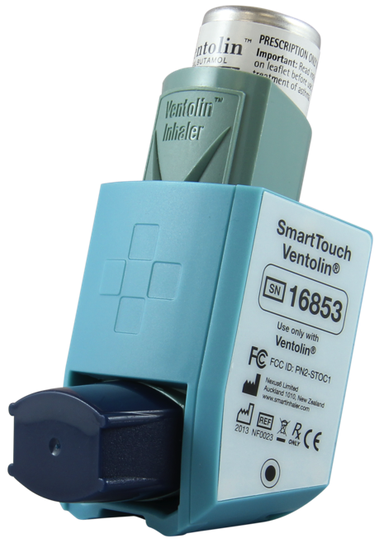
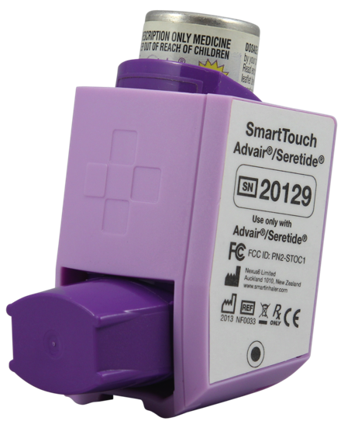
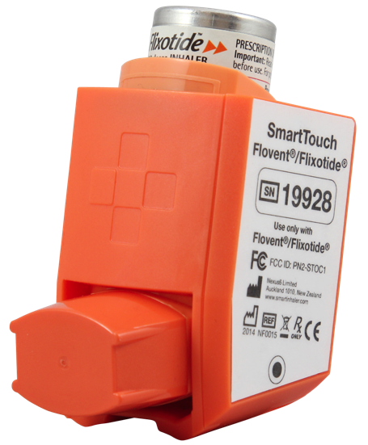
Smartinhalers Devices
Models for block buster medications e.g. Seretide, Flixotide, Ventolin
Records date & time of pMDI actuation *
NZ and TGA registered, and US FDA 510k clearance to market
Reminder (Beeper)
Rechargeable Battery and cable or disposable
Automatic Bluetooth communications to
Smartphone/Tablet
Quick Start Guide and Product Manual in the box
* Note: does not detect inhalation

Slide 34
Under-utilisation of ICS is associated with an increased risk of death from asthma¹
Fitted rate ratio for death from asthma as a function of the number of canisters of
inhaled corticosteroids used during the year before the index date¹
“The rate of death from asthma decreased by 21 percent with each additional canister of inhaled corticosteroids used in the previous year (adjusted rate ratio, 0.79; 95 percent confidence interval, 0.65 to 0.97).”¹
Study design: A population-based epidemiologic study (nested case-control design) of case patients (n=66) and controls (n=2,681) with severe asthma, predominantly derived from the computerised data bases of Saskatchewan Health.
There were 562 deaths in the cohort, of which 77 were classified as being due to asthma. Mean age of case patients was 30 years (range, 9-54 years).¹
Adapted from Suissa S, et al. 2000.¹
1 out of 3 patients (34%) with uncontrolled asthma do not take their preventer medication.²
1. Suissa S, et al. New Engl J Med 2000;343:332-6. 2. Reddel HK, et al. Med J Aust 2015 May 18;202(9):492-7.
Notes:
LINK: Conversely, there is under utilisation of ICS, which is associated with increased risk of death.¹
KEYPOINTS:
Regular low dose inhaled corticosteroid are associated with a decreased risk of death from asthma;¹ however, one out of three patients (34%) with uncontrolled asthma do not take their preventer medication.²
This study showed that the rate of death from asthma decreased by 21% with each additional canister of inhaled corticosteroids used in the previous year (adjusted rate ratio, 0.79; 95% CI: 0.65-0.97).¹
The rate of death from asthma among users of inhaled corticosteroids as compared with nonusers was reduced by about 50% with the use of ≥ 6 canisters per year.¹
Conversely, this data suggests that sporadic use of inhaled corticosteroids (fewer than 4 canisters per year) may be associated with higher rates of death from asthma.¹
BACKGROUND:
Study design: A population-based epidemiologic study (with a nested case-control design) of case patients (n=66) and controls (n=2681) with severe asthma, predominantly derived from the computerised data bases of Saskatchewan Health. There were 562 deaths in the cohort, of which 77 were classified as being due to asthma. Mean age of case patients was 30 years (range, 9-54 years).¹
REFERENCES: 1. Suissa S, et al. New Engl J Med 2000;343:332-6. 2. Reddel HK, et al. Med J Aust 2015 May 18;202(9):492-7.

Slide 35
Paradoxes of asthma management¹
Recent publication
Paradox 5: Dislocation between patient/doctor understanding of asthma control and frequency, impact & severity of symptoms
Treatment guidelines²
* Not for children<12 years
** For children 6-11 years, the preferred Step 3 treatment is medium dose ICS
# Low dose ICS/eformoterol is reliever for patients prescribed low dose budesonide/eformoterol or low dose beclometasone/eformoterol maintenance and reliever therapy
+ Tiotropium by mist inhaler is an add-on treatment for patients with a history of exacerbations; it is not indicated in children <12 years
Paradox 1: Step 1 SABA alone does not treat underlying inflammation associated with exacerbations
Paradox 2: Conflicting message between “prn” SABA” at Step 1, but at higher steps a “fixed dose” (i.e. “preventer” ICS) is used
Paradox 3: Patient misconception that SABA provides the most benefit, despite a switch from SABA “prn” to ICS fixed dose at Step 2
Paradox 4: Conflicting safety message: “SABA alone (step 1) is safe & LABA alone (step 3) unsafe”
STEP 5:
Refer for
add on treatment
e.g. Tiotropium*⁺
Anti IgE
Anti IL- 5*
STEP 4:
Medium/high dose
ICS + LABA
STEP 1
STEP 2:
Low dose ICS
STEP 3:
Low dose
ICS + LABA**
PREFERRED CONTROLLER
Consider low dose ICS
LTRA/Low dose theophylline*
Med/high dose ICS
Low dose ICS+LTRA
(or +theoph*)
+ tiotropium*⁺
High dose ICS + LTRA (or +theoph*)
Low dose OCS
Other controller
options
RELIEVER
“As needed” SABA
“As needed” SABA or low dose ICS/formoterol#
Poor patient understanding and confusion
Overuse of SABA and underuse of preventers is reinforced by paradoxes in current treatment.¹
1. O’Byrne PM, et al. Eur Respir J 2017 7;50:1701103 [https://doi.org/10.1183/13993003.01103-2017]. 2. Global Strategy for Asthma Management and Prevention (GINA). Updated 2017.
LTRA: leukotriene antagonist; OCS: oral corticosteroid
SABA: short acting beta₂-agonist; Theophy: theophylline
Notes:
LINK: In a recent 2017 publication, experts have suggested that overuse of SABA and under-use of preventers is reinforced by a number of paradoxes in our current treatment approach to asthma.¹
KEYPOINTS:
Current steps included in treatment guidelines, such as GINA (Global Initiative for Asthma), may unintentionally confuse patients and lead to poor understanding, reinforcing the inappropriate overuse of SABA and poor adherence to preventer medication.
The authors propose 5 paradoxes. The most important ones we’ll discuss are paradox 1, 2 and 3.
Paradox 1: “prn SABA” alone is introduced at step 1, but this does not treat the underlying inflammation. This approach reinforces the central role of SABA in asthma management, and sets a mindset to treat only when experiencing symptoms. Furthermore, the rapid relief of symptoms with SABA use, reinforces the “hero status” of the SABA inhaler.
Paradox 2: At step 1, the patient has autonomy (i.e. they treat only when they think they have symptoms). This self-management approach at Step 1, however, is at odds with Step 2, when the patient is asked to begin regular maintenance (“preventer”) medication, even when asymptomatic.
Paradox 3: The patient perceives SABA to be the most effective inhaler, despite a switch to a “fixed-dose” (i.e. regular maintenance ICS) at Step 2. Effectively, patients are required to “unlearn” their management approach at Step 1. Often patients are given more than one inhaler at this stage, which can be confusing. However, patients quickly learn the reliever works “quickly” reinforcing the misconception that it is the one that works, so they don’t need the preventer inhaler.
REFERENCE:
O’Byrne PM, et al. Eur J Respir J 2017;50:1701103.

Slide 36
New Zealand adult asthma guidelines
STEP UP
to achieve control and reduce risk of exacerbation
after a period of prolonged control to find and maintain lowest required step
STEP DOWN
“The SMART regimen is more effective at reducing severe exacerbations
than maintenance ICS/LABA with SABA reliever therapy. It is the preferred ICS/LABA regimen for treating patients at risk of severe exacerbations.” ¹
STEP 5:
Maintenance high dose (not standard)
ICS /LABA and SABA reliever therapy
or
High dose (not standard) single ICS/LABA Maintenance and Reliever Therapy
(SMART™ regimen)
and
Consider add on treatment and seek specialist advice
At every step consider treatable traits, including
overlapping disorders, comorbidities, environmental
and behavioural factors
STEP 4:
Maintenance high dose (not standard)
ICS /LABA and SABA reliever therapy
or
High dose (not standard) single ICS/LABA Maintenance and Reliever Therapy (SMART™ regimen)
STEP 3:
Maintenance standard dose ICS/LABA and SABA reliever therapy
or
Standard dose single ICS/LABA Maintenance and Reliever Therapy (SMART™ regimen)
STEP 2:
Maintenance standard dose ICS and SABA reliever therapy
STEP 1:
SABA reliever therapy
Adapted from Asthma & Respiratory Foundation NZ Adult Asthma Guidelines.¹
1. Asthma & Respiratory Foundation NZ: Adult Asthma Guidelines. NZMJ 18 November 2016, Vol 129 No 1445.
Available at: http://www.nzasthmaguidelines.co.nz/uploads/8/3/0/1/83014052/adult_asthma_guidelines.pdf. Accessed 11 Jan 2018.
STEP DOWN after a period of prolonged control to find and maintain lowest required step
Notes:
LINK: This slide summarises the 2016 updated NZ adult asthma guidelines.¹
[Note: The paediatric NZ asthma guidelines are summarised on the next slide]
KEYPOINTS:
As with the GINA guidelines a stepwise approach to asthma management is recommended whereby patients step up as required to achieve and maintain control of their asthma and reduce the risk of exacerbations, and step down after a period of prolonged control to find and maintain the lowest required step.¹
A key difference from the GINA guidelines (shown on previous slides) is that Symbicort Maintenance and Reliever Therapy is the preferred regimen at step 3 (starting with standard dosing) in patients at risk of severe exacerbation. The dose of Symbicort is increased to high dose at steps 4 and 5.¹
The NZ guidelines states: ““The SMART regimen is more effective at reducing severe exacerbations than maintenance ICS/LABA with SABA reliever therapy. It is the preferred ICS/LABA regimen for treating patients at risk of severe exacerbations.”¹
REFERENCE:
1. Asthma & Respiratory Foundation NZ: Adult Asthma Guidelines. Available at: http://www.nzasthmaguidelines.co.nz/uploads/8/3/0/1/83014052/adult_asthma_guidelines.pdf Accessed 11 Jan 2018.

Slide 37
Original Article
Inhaled Combined Budesonide–Formoterol as Needed in Mild Asthma
Paul M. O’Byrne, M.B., J. Mark FitzGerald, M.D., Eric D. Bateman, M.D., Peter J. Barnes, M.D., Nanshan Zhong, Ph.D., Christina Keen, M.D., Carin Jorup, M.D., Rosa Lamarca, Ph.D., Stefan Ivanov, M.D., Ph.D., and Helen K. Reddel, M.B., B.S., Ph.D.
N Engl J Med
Volume 378(20):1865-1876
May 17, 2018

Slide 38
Methods
52 week, d-b, p-c
Mild asthma >12yrs – documented history of reversible airflow obstruction
Step 2 asthma – uncontrolled on SABA alone or well controlled with low dose inhaled steroid
Two week run in with SABA prn alone – needed to use it at least 3 days in final week and have <2 days of >6puffs over the two weeks
Electronic monitoring and reminder of inhaler use (79% adherence to BD dosing)
Primary outcome: days of well controlled asthma on electronic diary
Three treatment arms

Slide 39
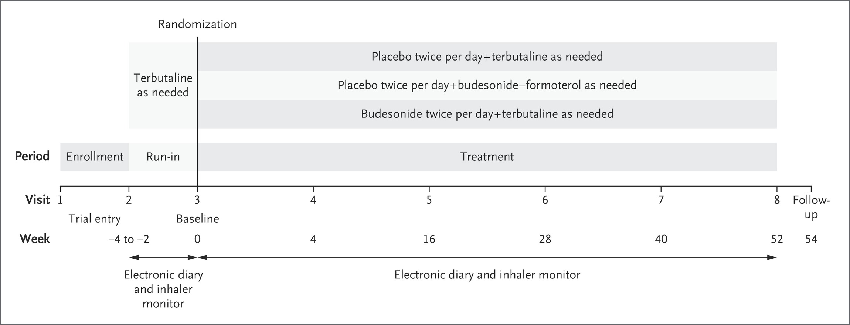
Trial Design.
O’Byrne PM et al. N Engl J Med 2018;378:1865-1876
Notes:
Figure 1 Trial Design. The terbutaline dose used during the run-in period (0.5 mg) corresponded to a delivered dose of 0.4 mg of terbutaline, delivered by a Turbuhaler during the double-blind phase for blinding purposes. Pretrial asthma treatments were discontinued at visit 2. In order for patients to be eligible to undergo randomization, morning and evening data must have been recorded for at least 8 days (any 8) of the previous 10 days of the run-in period. The dose of budesonide–formoterol during the treatment period corresponded to a delivered dose of 160 μg of budesonide and 4.5 μg of formoterol. An inhaler monitor recorded terbutaline use during the run-in period as well as the use of each blinded trial inhaler. An electronic diary recorded the morning and evening peak expiratory flow, asthma symptoms, and nighttime awakenings due to asthma and prompted the use of the blinded maintenance inhaler. Follow-up was conducted by means of a telephone call.

Slide 40
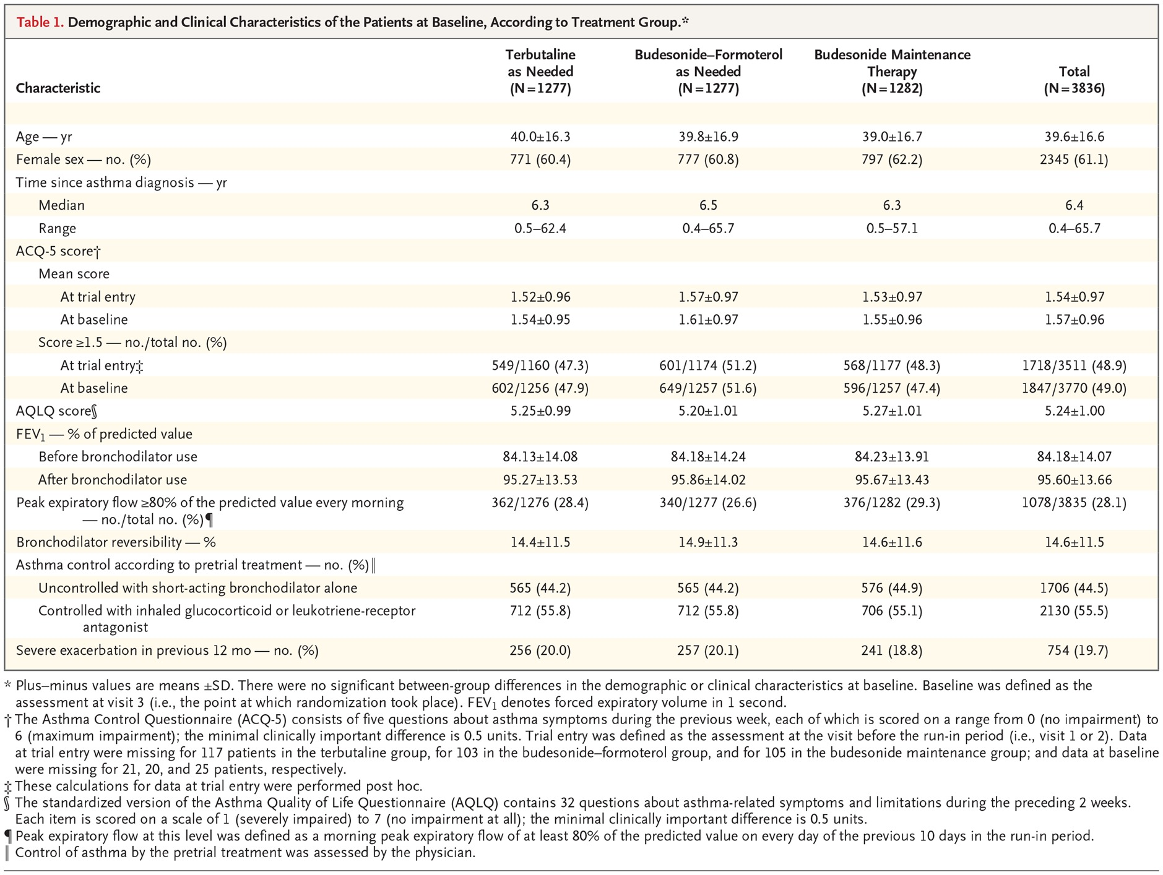
Demographic and Clinical Characteristics of the Patients at Baseline, According to Treatment Group.
O’Byrne PM et al. N Engl J Med 2018;378:1865-1876
Notes:
Table 1 Demographic and Clinical Characteristics of the Patients at Baseline, According to Treatment Group.

Slide 41
Results – Asthma controlled weeks
Primary end point
Bud-Form prn v Turbutaline prn – weeks of well controlled asthma 34.4 v 31.1% (OR 1.14, 95% CI 1.00-1.30, p=0.046)
Bud-Form prn v Budesonide BD – weeks of well controlled asthma 34.4 v 44.4%, OR 0.64, 95% CI 0.57-0.73

Slide 42
Overall Weeks of Well-Controlled Asthma, According to Data in the Electronic Diary.
O’Byrne PM et al. N Engl J Med 2018;378:1865-1876
Notes:
Figure 2 Overall Weeks of Well-Controlled Asthma, According to Data in the Electronic Diary.

Slide 43
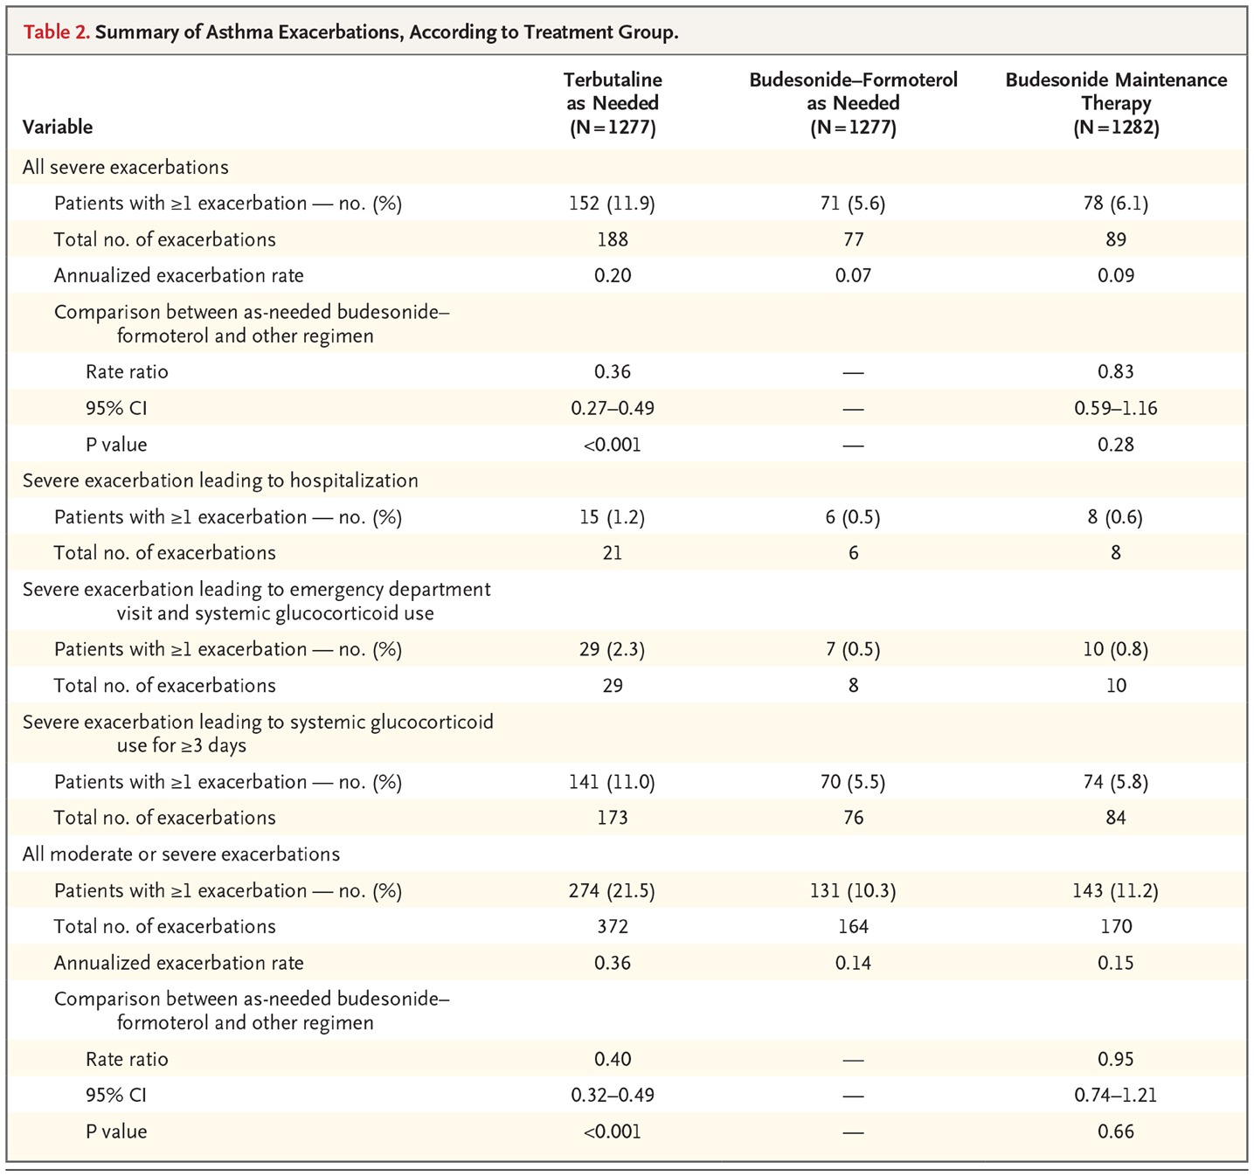
Summary of Asthma Exacerbations, According to Treatment Group.
64% lower exacerbation rate
O’Byrne PM et al. N Engl J Med 2018;378:1865-1876
Notes:
Table 2 Summary of Asthma Exacerbations, According to Treatment Group.

Slide 44
Results - Exacerbations
Calculations (on the back of a piece of paper)
  0.8% difference in hospitalizations, NNT 125 to stop 1 admission.
  But 500000 asthma patients in NZ, if 50% were mild then up to 2000 admissions stopped in NZ

Slide 45
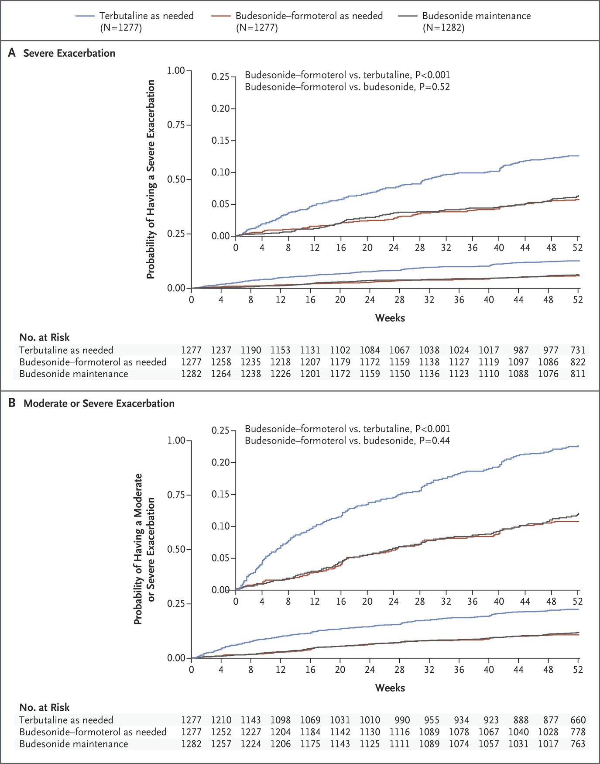
Time to First Exacerbation.
O’Byrne PM et al. N Engl J Med 2018;378:1865-1876
Notes:
Figure 3 Time to First Exacerbation. P values were not controlled for multiple comparisons. Insets show the same data on an enlarged y axis.

Slide 46
Changes in pre-bronchodilator FEV1
Bud-Form prn
Turb prn
Bud BD
+65mLs (47.6-82.4)
+11.2mL (-6.4-28.9)
+119.3 (101.9-136.7)

Slide 47
Conclusions
In patients with mild asthma, as-needed budesonide–formoterol provided superior asthma-symptom control to as-needed terbutaline, assessed according to electronically recorded weeks with well-controlled asthma, but was inferior to budesonide maintenance therapy.
Exacerbation rates with the two budesonide-containing regimens were similar and were lower than the rate with terbutaline.
Budesonide–formoterol used as needed resulted in substantially lower glucocorticoid exposure than budesonide maintenance therapy.

Slide 48
Original Article
As-Needed Budesonide–Formoterol versus Maintenance Budesonide in Mild Asthma
Eric D. Bateman, M.D., Helen K. Reddel, M.B., B.S., Ph.D., Paul M. O’Byrne, M.B., Peter J. Barnes, M.D., Nanshan Zhong, Ph.D., Christina Keen, M.D., Carin Jorup, M.D., Rosa Lamarca, Ph.D., Agnieszka Siwek-Posluszna, M.D., and J. Mark FitzGerald, M.D.
SYGMA-2
N Engl J Med
Volume 378(20):1877-1887
May 17, 2018

Slide 49
Methods
52 week, D-B, P-C study
Mild asthma, >12 years (4215 patients) – again Step 2
Similar run-in period off regular treatment – prn use needed for at least 3 days in the last week and <2 days of > 6
Two treatment arms: Bud-Form prn v Bud (200) BD + turb prn (but no daily reminders)
Primary outcome: Superiority changed to Non-inferiority, rate of severe exacerbations

Slide 50
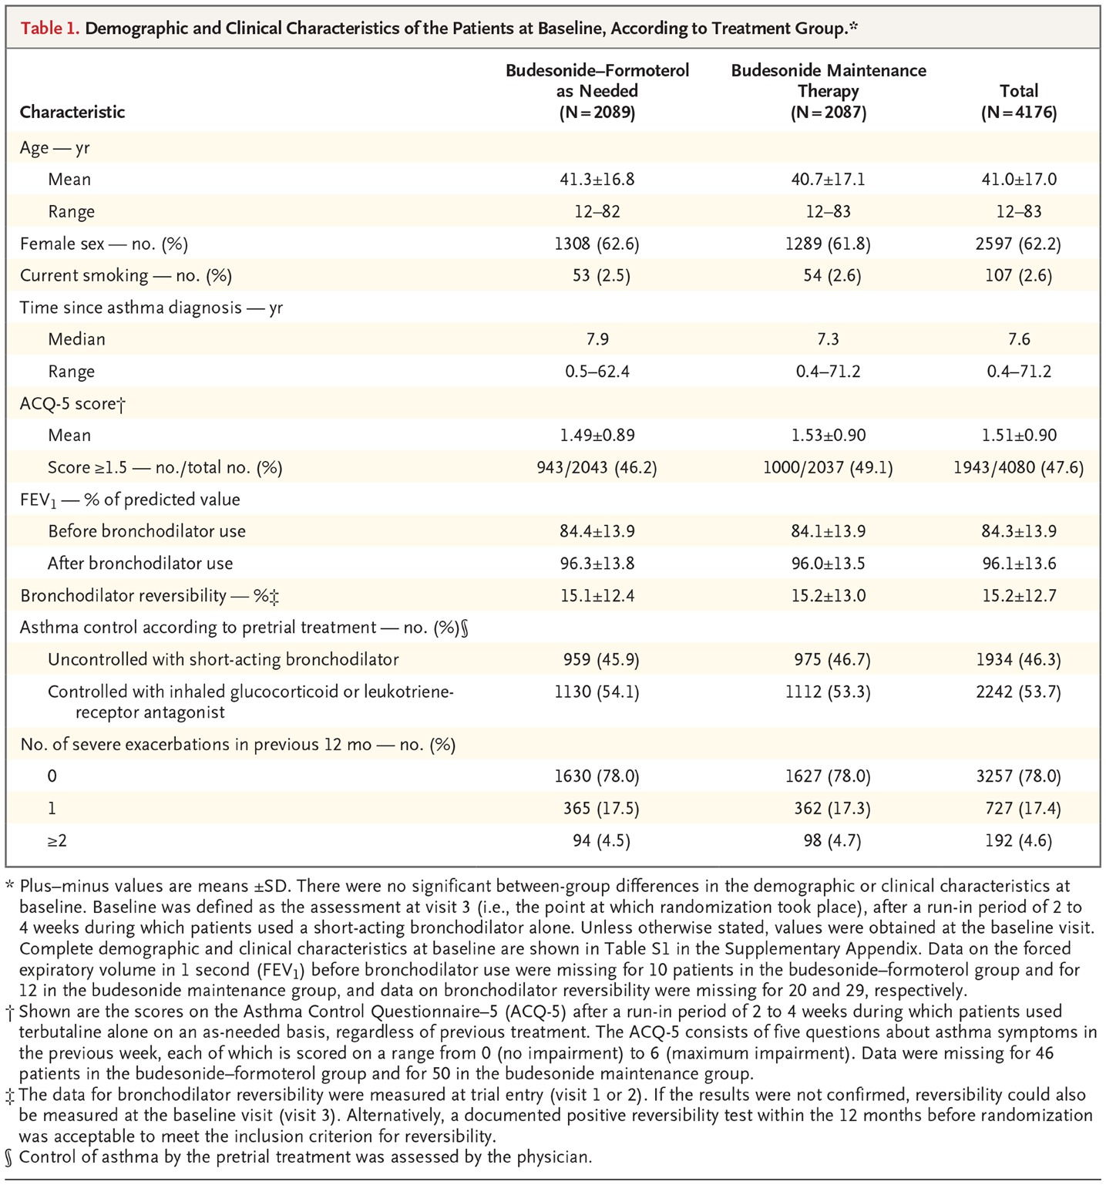
Demographic and Clinical Characteristics of the Patients at Baseline, According to Treatment Group.
Bateman ED et al. N Engl J Med 2018;378:1877-1887
Notes:
Table 1 Demographic and Clinical Characteristics of the Patients at Baseline, According to Treatment Group.

Slide 51
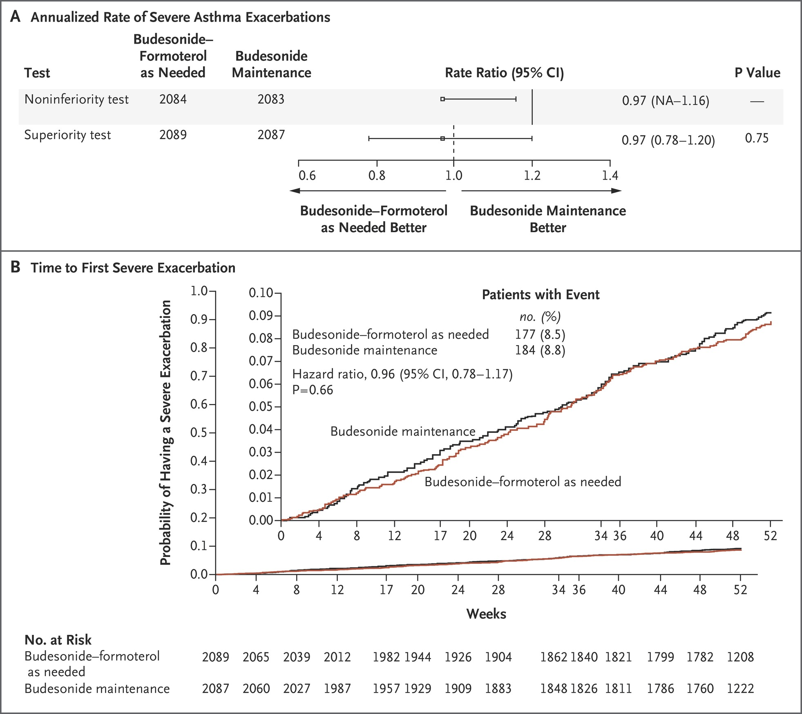
Annualized Rate of Severe Asthma Exacerbations and Time to First Severe Exacerbation.
Bateman ED et al. N Engl J Med 2018;378:1877-1887
Notes:
Figure 1 Annualized Rate of Severe Asthma Exacerbations and Time to First Severe Exacerbation. Panel A shows the rate ratios for the annualized rate of severe asthma exacerbations, which were tested for the noninferiority and superiority of budesonide–formoterol used as needed versus budesonide maintenance therapy. The solid line at 1.2 indicates the noninferiority margin, and the dashed line at 1.0 the superiority margin. All nine patients from France (five patients in the budesonide–formoterol group and four in the budesonide maintenance group) were excluded from the noninferiority test, because the protocol amendment introducing the noninferiority test was not approved by the ethics review board. The 95% confidence interval (CI) is one-sided for the noninferiority test and two-sided for the superiority test. NA denotes not applicable. Panel B shows the time to the first severe exacerbation in the full analysis set. The inset shows the same data on an enlarged y axis. P values were not controlled for multiple comparisons.

Slide 52
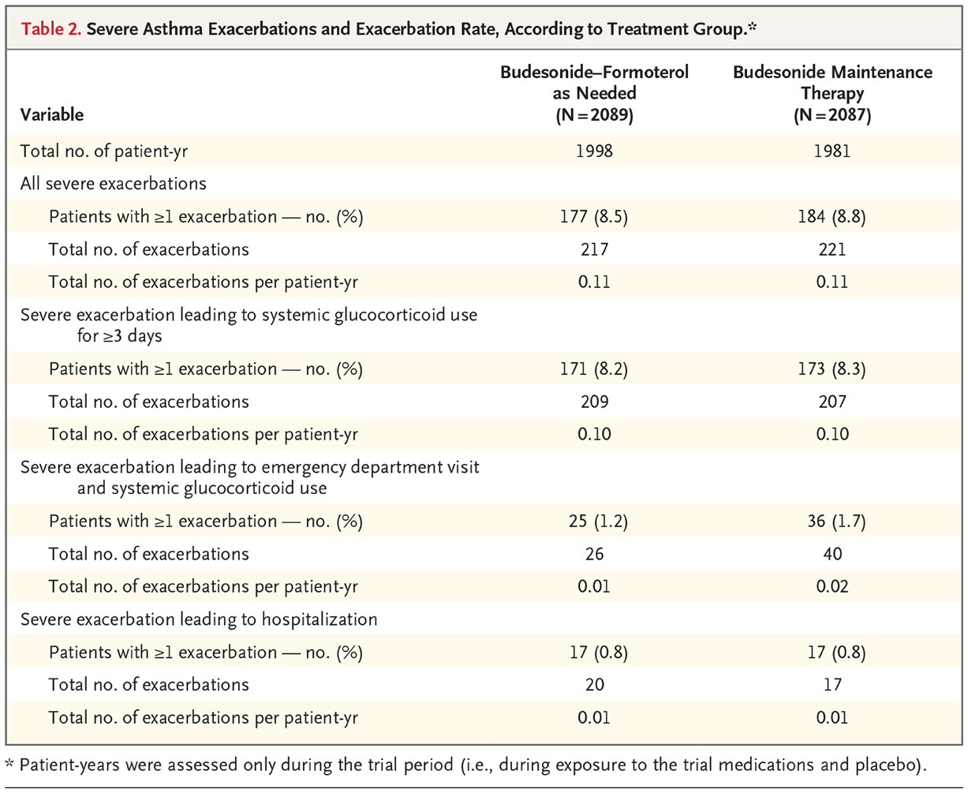
Severe Asthma Exacerbations and Exacerbation Rate, According to Treatment Group.
Bateman ED et al. N Engl J Med 2018;378:1877-1887
Notes:
Table 2 Severe Asthma Exacerbations and Exacerbation Rate, According to Treatment Group.

Slide 53
Results
Compliance 62-64%
Median daily dose of inhaled steroid was 75% lower in prn group

Slide 54
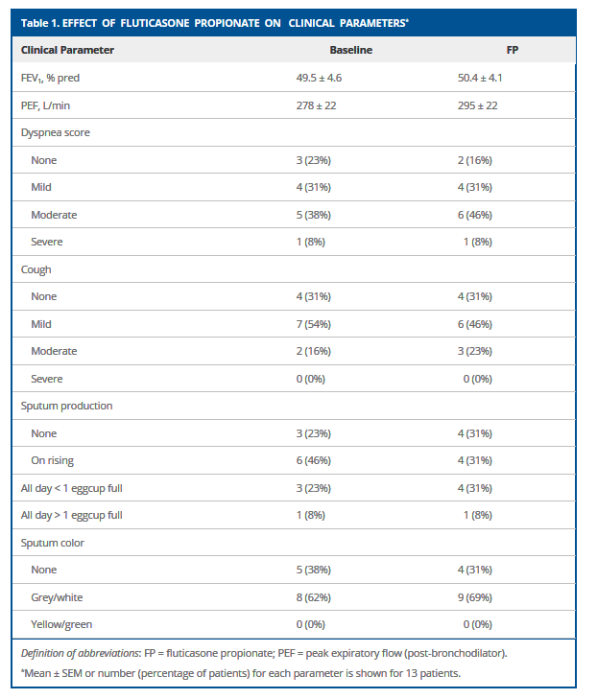

Slide 55
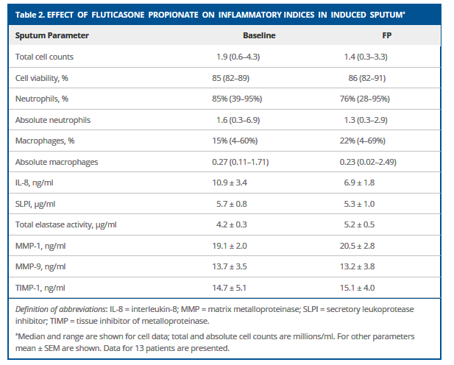
Effect of Fluticasone 500ug twice daily on inflammatory indices in induced sputum in COPD

Slide 56
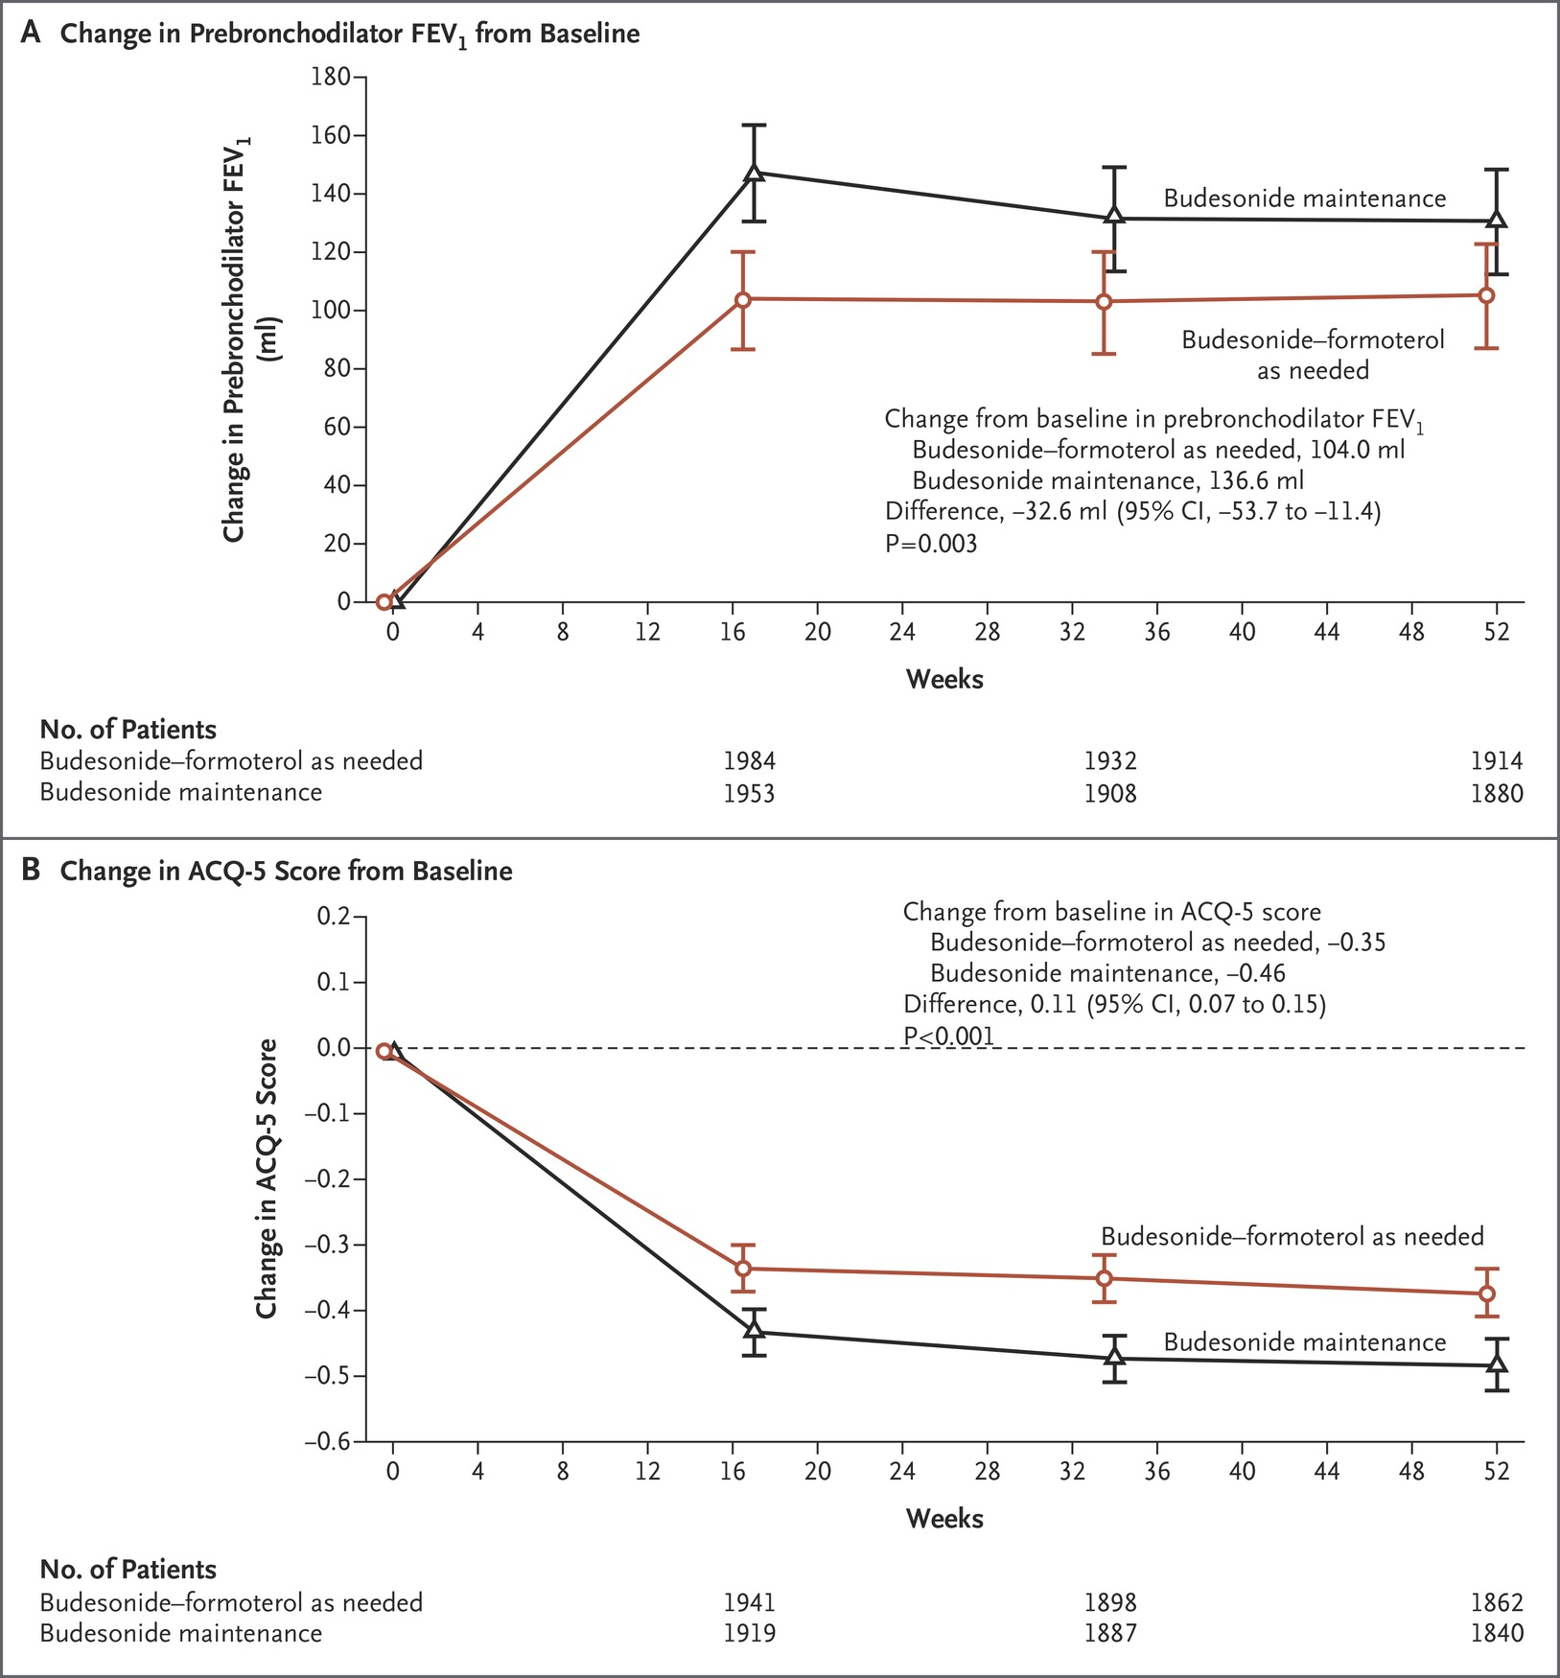
Forced Expiratory Volume in 1 Second (FEV₁) before Bronchodilator Use and Asthma Control Questionnaire–5 (ACQ-5) Scores.
Bateman ED et al. N Engl J Med 2018;378:1877-1887
Notes:
Figure 2 Forced Expiratory Volume in 1 Second (FEV₁) before Bronchodilator Use and Asthma Control Questionnaire–5 (ACQ-5) Scores. Panel A shows the least-squares mean FEV₁ before bronchodilator use over time. The approximate minimal clinically important difference is not well established but is likely to be 100 to 200 ml.¹⁶ 𝙸 bars indicate 95% confidence intervals in both panels. Panel B shows the least-squares mean scores on the ACQ-5 over time in the full analysis set (the dashed line at 0.0 indicates baseline). The ACQ-5 consists of five questions about asthma symptoms in the previous week, each of which is scored on a range from 0 (no impairment) to 6 (maximum impairment); the minimal clinically important difference is 0.5 units.¹⁷ P values were not controlled for multiple comparisons.

Slide 57
Conclusions
In patients with mild asthma, budesonide–formoterol used as needed was noninferior to twice-daily budesonide with respect to the rate of severe asthma exacerbations during 52 weeks of treatment but was inferior in controlling symptoms.
Patients in the budesonide–formoterol group had approximately one quarter of the inhaled glucocorticoid exposure of those in the budesonide maintenance group.

Slide 58
My Conclusions
Bud-Form prn is better than SABA – reduced exacerbations and hospitalizations – the days of SABA alone are numbered
Regular ics is still king – better lung function and symptom control, but at what cost and to what end?
But is Bud-Form prn more cost effective?
Bud-Form prn would solve some of the paradoxes – (1) using an inhaled steroid from the beginning, (3) the inhaler they get relief from also treats the asthma, the (4) inhaler they are started on doesn’t later become the problem
  But not all – (2) prn v fixed doses, (5) differences in asthma control perceptions

